Slide 1
Streaming Protocols – HTTP Based. -Abhishek J M

Slide 2

CMAF – COMMON MEDIA APPLICATION FORMAT
CMAF is a media container based on fragmented mp4.

Slide 3
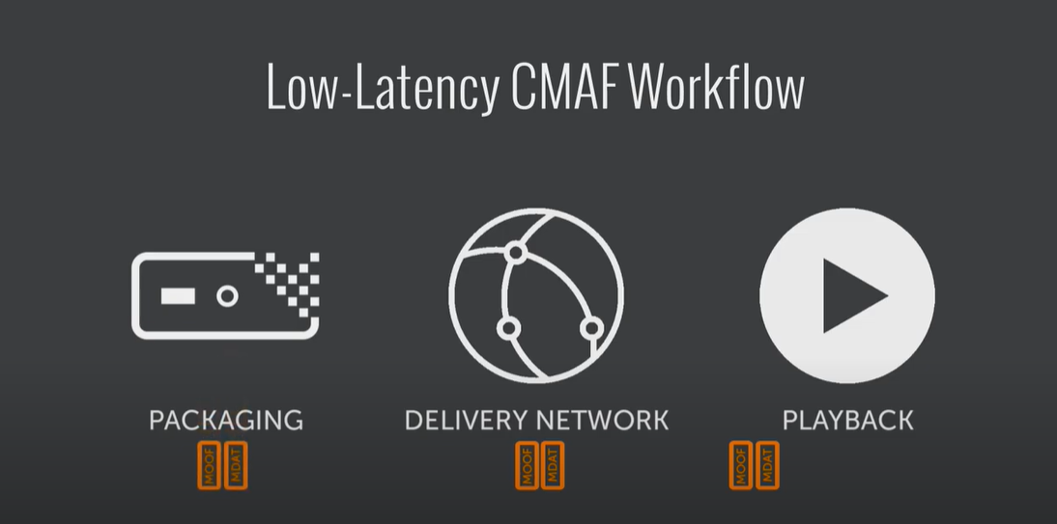
CMAF
THR PROCESS IS DIVIDED INTO SEGMENTS:
The data is compressed & transferred to network segment.
Here the data is divided to customer own delivery network.
And finally it is delivered to streaming segmented layer.
The small unit segments are called as chunks which are seperated during packaging.

Slide 4
Benefits
These formats reduces the complexity of streaming media comparable to other formats.
It saves delivery cost.
Reduces the latency of the network.
The simple implementation of this format reduces double encoding & double storing.

Slide 5
Microsoft smooth Streaming
Adaptive bitrate streaming is an established standard for delivering video online.
There are many reasons for the increase in use and popularity of this type of protocol because broader device compatibility, and cost efficiency. For the end-user, it offers faster start-up/seek times, no buffering or stuttering & an optimized playback experience.
One of the first to introduce this type of adaptive bitrate streaming was Microsoft, and they refer to it simply as Microsoft Smooth Streaming or MSS.

Slide 6
How does it work?
Smooth Streaming is a hybrid media delivery method. It acts like streaming, but is based on HTTP progressive download. The HTTP downloads are performed in a series of small chunks, allowing the media to be easily and cheaply cached along the edge of the network, closer to clients.

Slide 7
Pros & Cons
Since the player has access to all this at the establishment of the connection, it has all the data necessary for an informed decision on the best bit rate to select for the delivery of the video. This is important because ABR is the only technology today that gives the device control over the selection of the version (and therefore quality and cost) of the video to be delivered.
Interoperability, Economics are the cons.

Slide 8
Adobe HDS
Adobe HTTP Dynamic Streaming (HDS) is the best way to deliver multi-bitrate content over HTTP to Adobe Flash Player or Adobe AIR. Adobe HDS provides all of the capabilities required for delivering premium digital video and audio.
Its as similar as Adaptive bitrate streaming of MSS.

Slide 9
New Technologies

Slide 10
STR [ Secure Reliable Transport ]
Secure Reliable Transport [STR] is an open source video transport protocol.
it optimizes streaming performance across unpredictable networks, such as the Internet, by dynamically adapting to the real-time network conditions between transport endpoints.
SRT only attempts to retransmit packets for a limited amount of time based on the latency as configured by the application.

Slide 11
WebRTC [Web Real-Time Communication ]
WebRTC (Web Real-Time Communication) is a free, open-source project that provides web browsers and mobile applications with real-time communication (RTC) via simple application programming interfaces (APIs).
It allows audio and video communication to work inside web pages by allowing direct peer-to-peer communication, eliminating the need to install plugins or download native apps.
Its mission is to "enable rich, high-quality RTC applications to be developed for the browser, mobile platforms, and IoT devices, and allow them all to communicate via a common set of protocols.

